Slide 1







Slide 2



Project Overview
Our Goal:To validate DIASPOCARE’s ability to detect & analyze, contain, eradicate, and recover from a UDP-based DNS flooding while ensuring proper engagement with external partners and internal host forensics in accordance with NIST SP 800‑61 Rev. 2.”
Scope: All DiaspoCare employees
Objectives :Test and evaluate the organization’s response to a DNS-based Distributed Denial of Service (DDoS) attack, including communication, containment, and recovery procedures.
Type of Exercise : Facilitated tabletop Discussion
Duration: 25 Minutes
Agenda:
Introductions
Incident Response Plan Overview
Scenario Briefing
Phase 1 – Preparation,Detection & Analysis
Phase 2 – Containment, Eradication & Recovery
Phase 3 – Post-Incident Activities
Discussion & wrap-Up What worked? What didn’t?

Slide 3

DNS Flood & Internal Host Breach Team
Team Members
Incident Response Manager
Information Assurance IT Security
IT Support Lead
Public Affairs and Media Relations
Legal/Compliance Advisor
HR Representative
Financial Manager
Digital Forensics Expert
﻿﻿Physical Security and Facilities Management
Business Continuity Officer

Slide 4
🔐 Tabletop Exercise:
DNS Flood & Internal Host Breach
"On a Saturday afternoon, external users start having problems accessing the organisation's public websites. Over the next hour, the problem worsens to the point where nearly every access attempt fails. Meanwhile, a member of the organisation's networking staff responds to alerts from an Internet border router and determines that the organisation's Internet bandwidth is being consumed by an unusually large volume of User Datagram Protocol (UDP) packets to and from both the organisation's public DNS servers. Analysis of the traffic shows that the DNS servers are receiving high volumes of requests from a single external IP address. Also, all the DNS requests from that address come from the same source port".

Slide 5

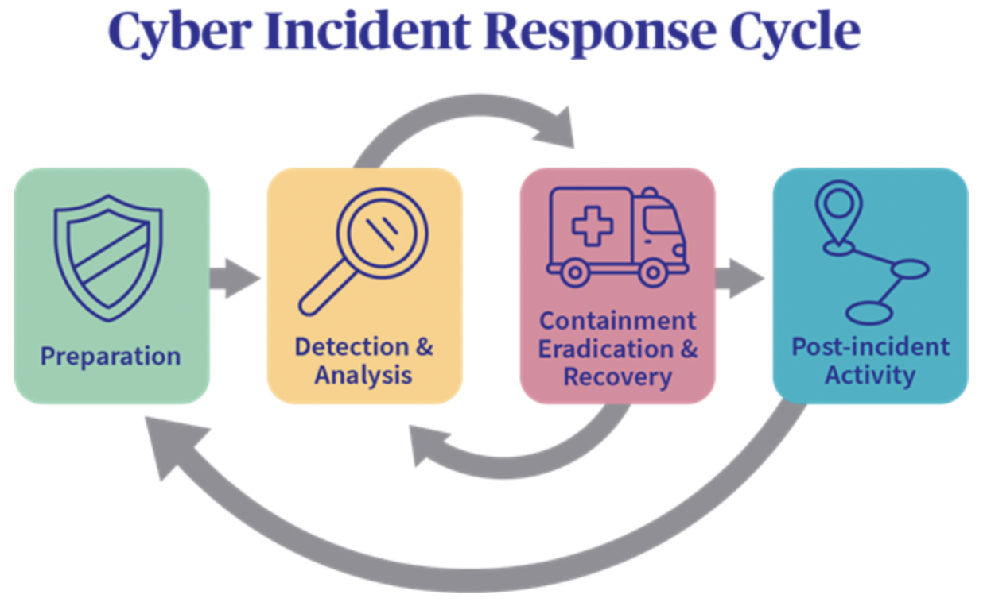

Slide 6
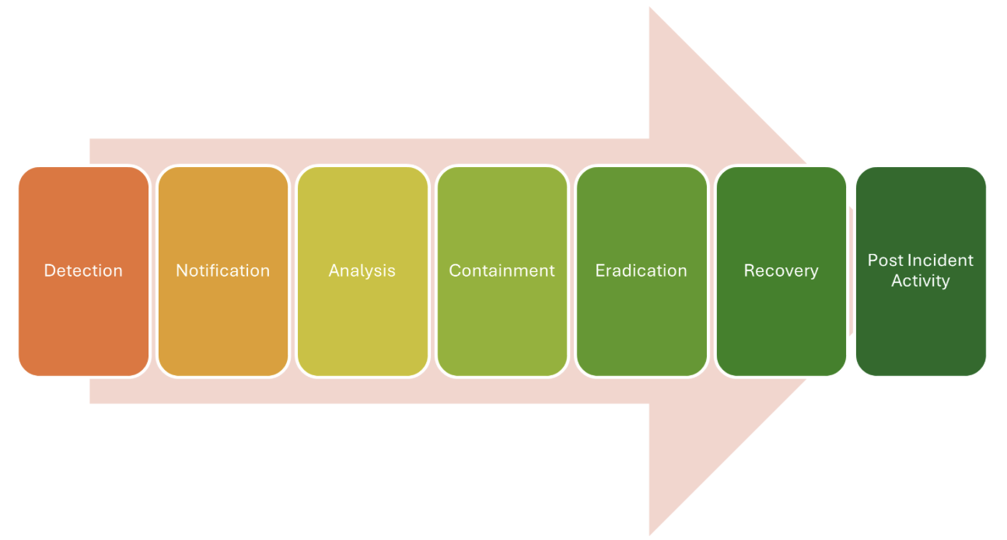







Phases of Incident Response

Slide 7
Phases of Incident Response

Slide 8
Phases of Incident Response

Slide 9
Phases of Incident Response

Slide 10
Phases of Incident Response

Slide 11
Phases of Incident Response

Slide 12


Key Findings
⁠Service Disruption: Public websites became inaccessible due to DNS service degradation
Traffic Pattern: High volume of UDP packets targeting DNS servers
Source Analysis: All malicious DNS requests originated from a single external IP and port
Bandwidth Saturation: Internet bandwidth was consumed, impacting all external-facing services
Alert Response: Border router alerts helped identify the abnormal traffic

Slide 13

Lessons Learned
⁠(1) Proactive DNS Flood Detection
Single IP + fixed source port suggests automated attack
Action: Implement rate limiting and anomaly detection
⁠(2) UDP-Based Attacks Are Fast and Disruptive
UDP’s connectionless nature enables effective flooding
Action: Enable DNS rate controls and UDP flood protection mechanism.
(3) Border Routers as First Line of Defense
Alerts helped surface the issue quickly
Action: Ensure volumetric alert thresholds are active
(4) DNS Redundancy Is Essential
⁠Overreliance on a single configuration increased vulnerability
Action: Deploy anycast and geo-distributed DNS infrastructure
(5) Source Port Uniformity Suggests Attack Automation
Fixed source port is abnormal in legitimate traffic
Action: Block patterns matching automated abuse
(6) ⁠External Threat Intelligence Needed
Blocking and blacklisting depends on collaboration
Action: Integrate threat feeds and ISP/CERT partnerships

